Slide 1
Data Mining:
Concepts and Techniques
Mining time-series data

Slide 2
Time-Series and Sequential Pattern Mining
Regression and trend analysis—A statistical approach
Similarity search in time-series analysis
Sequential Pattern Mining
Markov Chain
Hidden Markov Model

Slide 3
Mining Time-Series Data
Time-series database
  Consists of sequences of values or events changing with time
  Data is recorded at regular intervals
  Characteristic time-series components
    Trend, cycle, seasonal, irregular
Applications
  Financial: stock price, inflation
  Industry: power consumption
  Scientific: experiment results
  Meteorological: precipitation

Slide 4
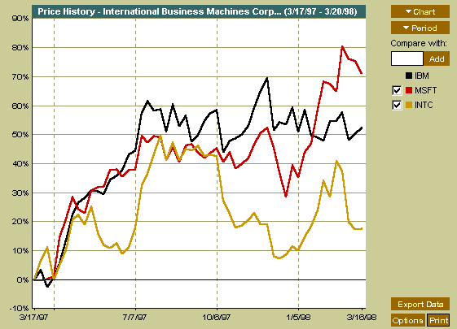
A time series can be illustrated as a time-series graph which describes a point moving with the passage of time

Slide 5
Categories of Time-Series Movements
Categories of Time-Series Movements
  Long-term or trend movements (trend curve): general direction in which a time series is moving over a long interval of time
  Cyclic movements or cycle variations: long term oscillations about a trend line or curve
    e.g., business cycles, may or may not be periodic
  Seasonal movements or seasonal variations
    i.e, almost identical patterns that a time series appears to follow during corresponding months of successive years.
  Irregular or random movements
Time series analysis: decomposition of a time series into these four basic movements
  Additive Modal: TS = T + C + S + I
  Multiplicative Modal: TS = T × C × S × I

Slide 6
Estimation of Trend Curve
The freehand method
  Fit the curve by looking at the graph
  Costly and barely reliable for large-scaled data mining
The least-square method
  Find the curve minimizing the sum of the squares of the deviation of points on the curve from the corresponding data points
The moving-average method

Slide 7
Moving Average
Moving average of order n
  Smoothes the data
  Eliminates cyclic, seasonal and irregular movements
  Loses the data at the beginning or end of a series
  Sensitive to outliers (can be reduced by weighted moving average)

Slide 8
Trend Discovery in Time-Series (1): Estimation of Seasonal Variations
Seasonal index
  Set of numbers showing the relative values of a variable during the months of the year
  E.g., if the sales during October, November, and December are 80%, 120%, and 140% of the average monthly sales for the whole year, respectively, then 80, 120, and 140 are seasonal index numbers for these months
Deseasonalized data
  Data adjusted for seasonal variations for better trend and cyclic analysis
  Divide the original monthly data by the seasonal index numbers for the corresponding months

Slide 9
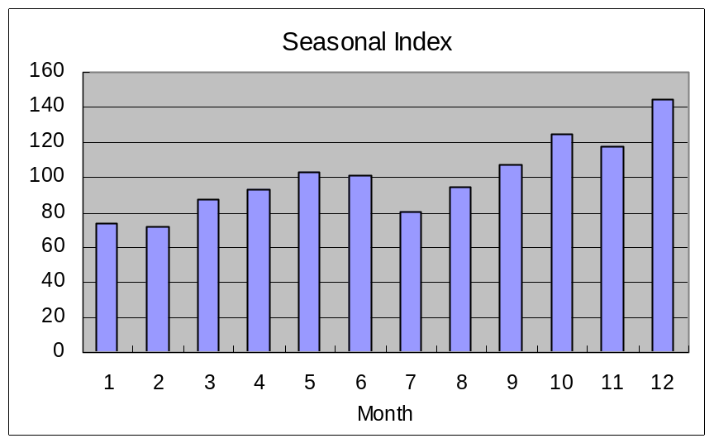
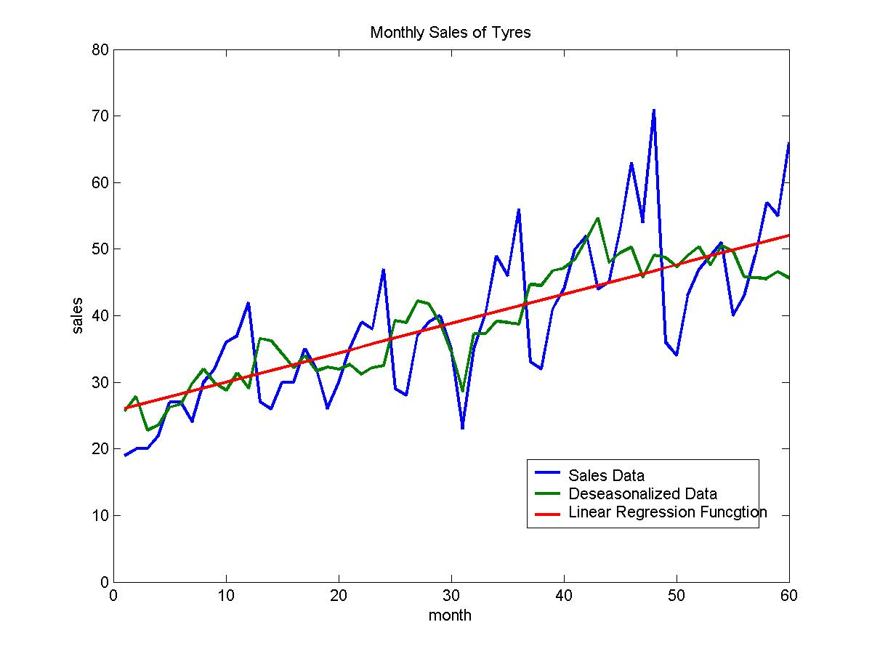
Seasonal Index
Raw data from http://www.bbk.ac.uk/manop/man/docs/QII_2_2003%20Time%20series.pdf

Slide 10
Trend Discovery in Time-Series (2)
Estimation of cyclic variations
  If (approximate) periodicity of cycles occurs, cyclic index can be constructed in much the same manner as seasonal indexes
Estimation of irregular variations
  By adjusting the data for trend, seasonal and cyclic variations
With the systematic analysis of the trend, cyclic, seasonal, and irregular components, it is possible to make long- or short-term predictions with reasonable quality

Slide 11
Similarity Search in Time-Series Analysis
Normal database query finds exact match
Similarity search finds data sequences that differ only slightly from the given query sequence
Two categories of similarity queries
  Whole matching: find a sequence that is similar to the query sequence
  Subsequence matching: find all pairs of similar sequences
Typical Applications
  Financial market
  Market basket data analysis
  Scientific databases
  Medical diagnosis

Slide 12
Data Transformation
Many techniques for signal analysis require the data to be in the frequency domain
Usually data-independent transformations are used
  The transformation matrix is determined a priori
    discrete Fourier transform (DFT)
    discrete wavelet transform (DWT)
The distance between two signals in the time domain is the same as their Euclidean distance in the frequency domain

Slide 13
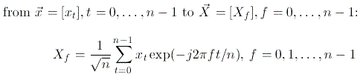
Discrete Fourier Transform
DFT does a good job of concentrating energy in the first few coefficients
If we keep only first a few coefficients in DFT, we can compute the lower bounds of the actual distance
Feature extraction: keep the first few coefficients (F-index) as representative of the sequence

Slide 14
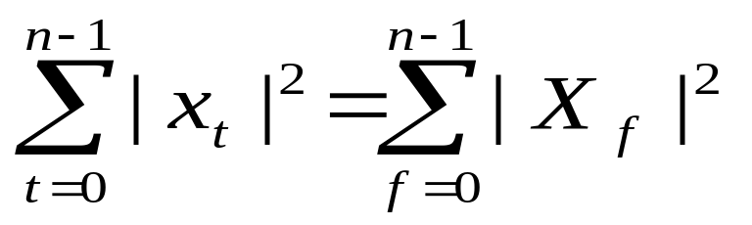
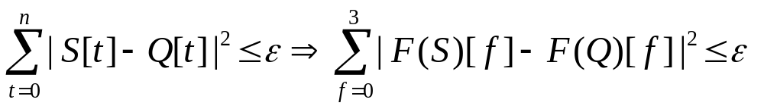
DFT (continued)
Parseval’s Theorem
The Euclidean distance between two signals in the time domain is the same as their distance in the frequency domain
Keep the first few (say, 3) coefficients underestimates the distance and there will be no false dismissals!

Slide 15
Multidimensional Indexing in Time-Series
Multidimensional index construction
  Constructed for efficient accessing using the first few Fourier coefficients
Similarity search
  Use the index to retrieve the sequences that are at most a certain small distance away from the query sequence
  Perform post-processing by computing the actual distance between sequences in the time domain and discard any false matches

Slide 16
Subsequence Matching
Break each sequence into a set of pieces of window with length w
Extract the features of the subsequence inside the window
Map each sequence to a “trail” in the feature space
Divide the trail of each sequence into “subtrails” and represent each of them with minimum bounding rectangle
Use a multi-piece assembly algorithm to search for longer sequence matches

Slide 17
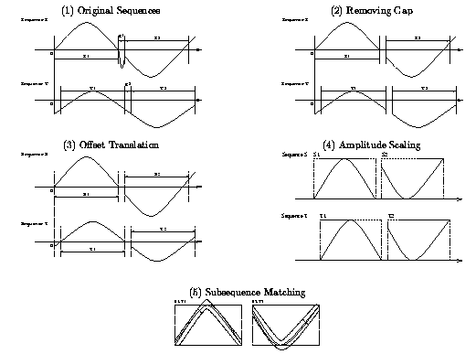
Analysis of Similar Time Series

Slide 18
Enhanced Similarity Search Methods
Allow for gaps within a sequence or differences in offsets or amplitudes
Normalize sequences with amplitude scaling and offset translation
Two subsequences are considered similar if one lies within an envelope of ε width around the other, ignoring outliers
Two sequences are said to be similar if they have enough non-overlapping time-ordered pairs of similar subsequences
Parameters specified by a user or expert: sliding window size, width of an envelope for similarity, maximum gap, and matching fraction

Slide 19
Steps for Performing a Similarity Search
Atomic matching
  Find all pairs of gap-free windows of a small length that are similar
Window stitching
  Stitch similar windows to form pairs of large similar subsequences allowing gaps between atomic matches
Subsequence Ordering
  Linearly order the subsequence matches to determine whether enough similar pieces exist

Slide 20
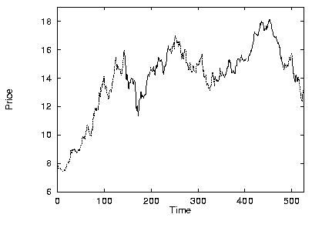
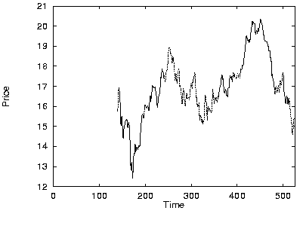
Similar Time Series Analysis
VanEck International Fund
Fidelity Selective Precious Metal and Mineral Fund
Two similar mutual funds in the different fund group

Slide 21
Query Languages for Time Sequences
Time-sequence query language
  Should be able to specify sophisticated queries like
Find all of the sequences that are similar to some sequence in class A, but not similar to any sequence in class B
  Should be able to support various kinds of queries: range queries, all-pair queries, and nearest neighbor queries
Shape definition language
  Allows users to define and query the overall shape of time sequences
  Uses human readable series of sequence transitions or macros
  Ignores the specific details
    E.g., the pattern up, Up, UP can be used to describe increasing degrees of rising slopes
    Macros: spike, valley, etc.

Slide 22
References on Time-Series & Similarity Search
R. Agrawal, C. Faloutsos, and A. Swami. Efficient similarity search in sequence databases. FODO’93 (Foundations of Data Organization and Algorithms).
R. Agrawal, K.-I. Lin, H.S. Sawhney, and K. Shim. Fast similarity search in the presence of noise, scaling, and translation in time-series databases. VLDB'95.
R. Agrawal, G. Psaila, E. L. Wimmers, and M. Zait. Querying shapes of histories. VLDB'95.
C. Chatfield. The Analysis of Time Series: An Introduction, 3rd ed. Chapman & Hall, 1984.
C. Faloutsos, M. Ranganathan, and Y. Manolopoulos. Fast subsequence matching in time-series databases. SIGMOD'94.
D. Rafiei and A. Mendelzon. Similarity-based queries for time series data. SIGMOD'97.
Y. Moon, K. Whang, W. Loh. Duality Based Subsequence Matching in Time-Series Databases, ICDE’02
B.-K. Yi, H. V. Jagadish, and C. Faloutsos. Efficient retrieval of similar time sequences under time warping. ICDE'98.
B.-K. Yi, N. Sidiropoulos, T. Johnson, H. V. Jagadish, C. Faloutsos, and A. Biliris. Online data mining for co-evolving time sequences. ICDE'00.
Dennis Shasha and Yunyue Zhu. High Performance Discovery in Time Series: Techniques and Case Studies, SPRINGER, 2004

